Slide 1
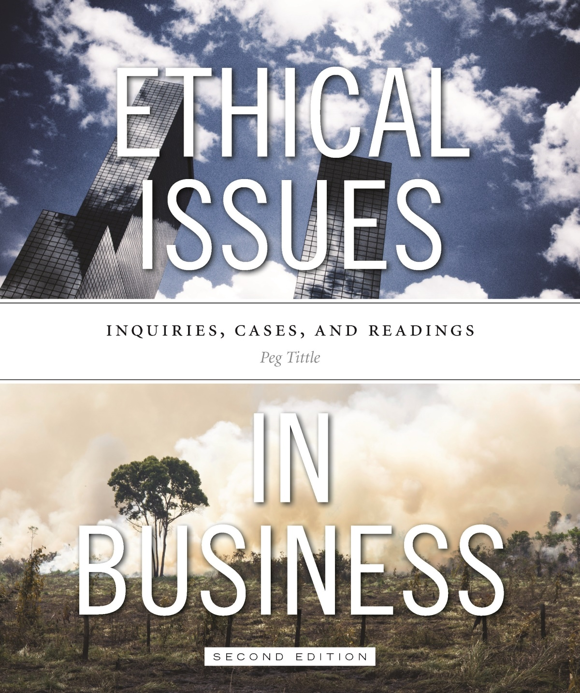
PART IV
Ethical Issues in Business
Institutionalizing Ethics

Slide 2
Introduction
Some companies formalize their ethics, adding organizational behaviour to individual ethical behaviour

Slide 3
Ethics Offices / Officers / Committees
Companies can appoint ethics officer or an ethics committee
Responsible for (say Ferrell & Fraedrich):
Coordinating ethical compliance program with leadership
Developing, revising and disseminating a code of ethics
Developing effective communication of ethical standards
Establishing audit and control systems to determine effectiveness of program
Developing consistent means of enforcing codes an standards
Reviewing and modifying the ethics program to improve effectiveness
May act as support system for people trying to do the right thing

Slide 4
Ethics Offices / Officers / Committees Cont’d…
Available for consultations to resolve ethical dilemmas
Consultation process:
Identify the ethical issue (question to be answered)
Identify the relevant facts, consulting all stakeholders
a) Identify the relevant moral principles and values
b) Rank them
a) List all the decision options
b) Identify the consequences of each option
Align the options with the values and principles – which are upheld, which are violated?
Decide on the “rightest” thing to do
Repeat the process for deciding the “rightest” way of moving forward

Slide 5
Ethics Consultants
Often perform same tasks as in-house officers
May belong to the “Ethics Practitioners Association of Canada”
May also provide additional services:
External ethical audits
Newsletter
Information for ethical investors and shoppers
Database of corporate social performance

Slide 6
Ethics Programs
Consists of some or all of:
Code of ethics
Ethical policies and procedures
Educational component → what and how ethical policies are applied
Whistle-blowing system / “ethics hotline”
Administer surveys to determine current levels of ethical awareness and practices
Ongoing assessment tools to monitor program

Slide 7
Ethics Programs Cont’d…
Two approaches:
Compliance strategy → prevent, detect and punish
Integrity strategy → to define and give life to an organization’s guiding values, to create an environment that supports ethical behavior and to instill shared accountability
Especially valuable when company conducts business in many locations
Increases consistency in decision making

Slide 8
Codes of Ethics
In order to be successful, code of ethics must be:
Developed with input from all levels of the company
Defensible by reasonable argument
Binding to people at all levels
Updating and enforcing the code is important
Can be implicit vs. explicit:
Implicit → more appropriately called “corporate culture”
Explicit codes range from mission statements to extensive statements of policy and procedure

Slide 9
Codes of Ethics Cont’d…
Common criticisms:
Just for show
Too simplistic to be effective
The terms – typically values – are not defined
Suggests that work morality differs from “life” morality
Isn’t it enough to have the Canadian Criminal Code and all other legislation that forms our justice system?

Slide 10
Codes of Ethics Cont’d…
Why bother?
Reminder to be ethically involved, to do the right thing
Counteract pressures to not do the right thing
With time, can transcend both the profit motive and the immediate corporate environment

Slide 11
Ethics Audits
Measures how well a company is doing with respect to ethical policies and practices
Poses questions about:
Manufacturing processes
Personnel policies
Dealings with suppliers
Financial reporting
Sales techniques
Provides systemic and objective survey of the ethical condition of the organization

