Slide 1
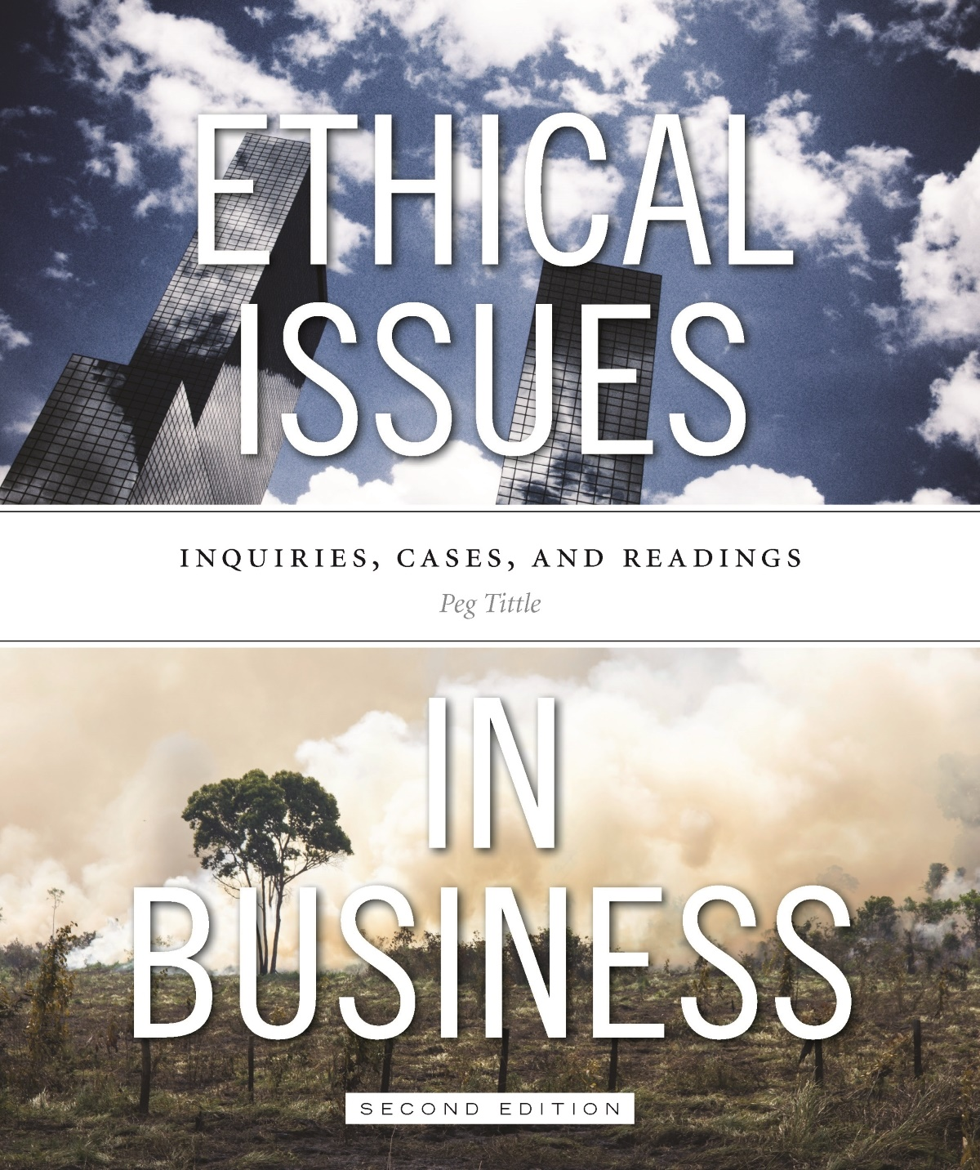
PART III
Ethical Issues in Business
Chapter 8 The Medical Business

Slide 2
Introduction
New challenges in the medical business:
Current trends toward privatization
Development of medical technologies
Resource-allocation problems:
Due to population growth, ability to lengthen lives and immigration
How to chose who lives and who dies?
Particularly critical during epidemics

Slide 3
Ethical Issues in Medical Business
Client confidentiality is increasingly important
Whose rights take precedence?
How to advertise medical services?
Full disclosure of all side effects?
Free pharmaceutical samples for physicians? All-expense paid trips to conferences?
Does “advertising behavior” put undue pressure on physicians to prescribe certain products?

Slide 4
Ethical Issues in Medical Business Cont’d…
What services will be provided?
Abortion, physician-assisted suicide, euthanasia?
In-vitro fertilization, surrogacy, sex selection?
Stem cell research, cloning, fetal tissue transplants?
Genetic research and screening?
Genetic modification? Who owns genetic material?
“Smart drugs” (e.g. Ritalin during exam week)?

Slide 5
Ethical Issues in Medical Business Cont’d…
Should products be patented?
What is your motivation for patenting?
Would you suppress an alternative remedy or cure so everyone buys yours?
Can you patent your products?...are they really yours for the owning (even folk remedies, or products resulting from collective research)?
Can human genes be patented?
Do patents promote or inhibit research?
Do researchers have the moral obligation to share?
Should you try to prevent generic versions of your drugs?

Slide 6
Ethical Issues in Medical Business Cont’d…
Should products be tested on animals?
Does it matter whether your product is life-saving or just life-enhancing?
Does it matter whether it benefits only humans or the animals used for testing as well?
Does it matter what effect, what degree of harm, your testing has on the animal – discomfort, pain, death?

Slide 7
Ethical Issues in Medical Business Cont’d…
What level of safety is required for your products?
Should people have the right to buy drugs or procedures that are not completely tested?
What risk is acceptable?
Workplace safety issues:
Consider potential for contagion (e.g. Would you hire HIV-positive surgeon?)

Slide 8
Ethical Issues in Medical Business Cont’d…
Should doctors be able to refuse demands for futile treatment?
Is the patient considered a customer?
Is it morally permissible to profit on life and death?
E.g. marking up blood in the midst of a natural disaster
Do you want to consult a doctor whose bottom line is profit?
“Economic medicalization” → turning non-medical problems into medial problems in order to profit

