Slide 1
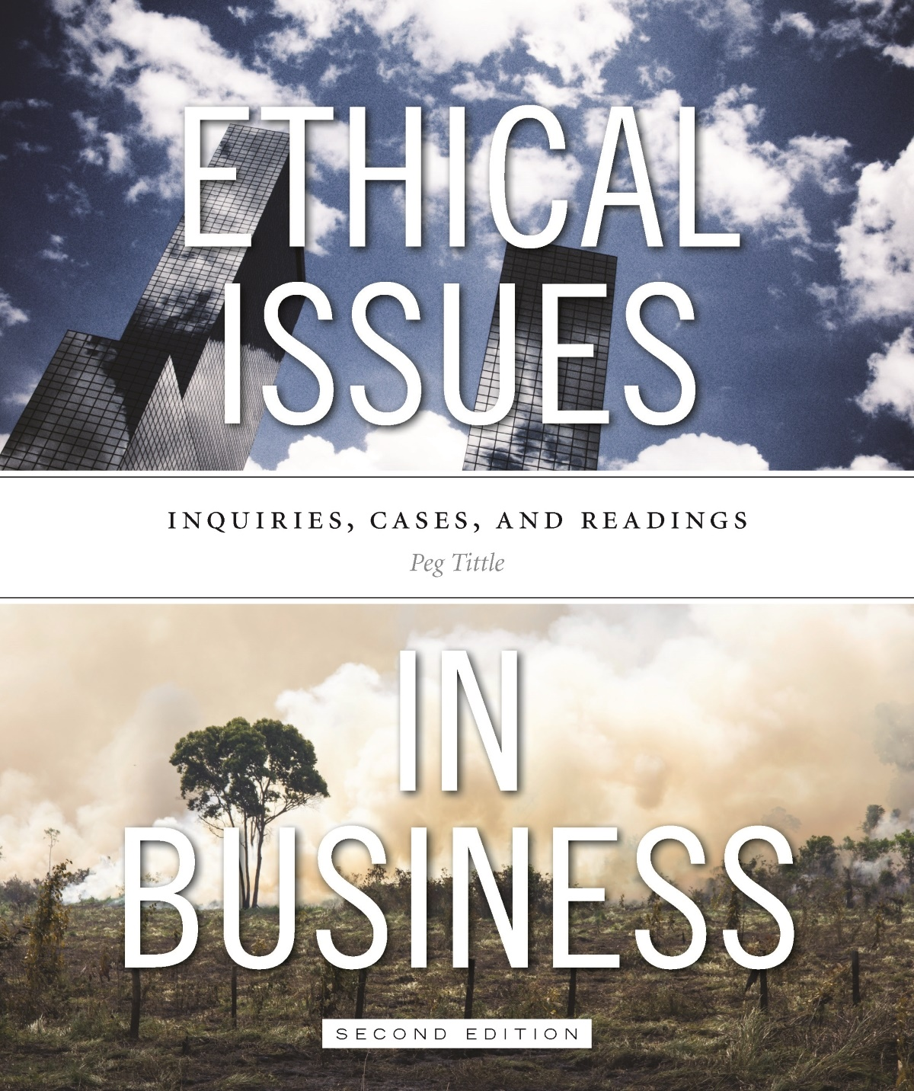
PART III
Ethical Issues in Business
Chapter 7 Profit & Capitalism

Slide 2
Introduction
Is pursuit of profit a given?
Is the maximization of profit good, and the reason for being in business?
Does pursuit of profit override morality?
The pursuit of profit must be justified on ethical grounds
How would businesses change if guided by all of the consequences of our actions (not just profit and loss)?

Slide 3
Introduction
What is the ethical justification for profit?
One view is that the existence of profit (or loss) indicates miscalculation – either you charged more for your product or you paid less than you should have for supplies or labour
Ethical remedy may be to just charge / pay what you should have
Otherwise, your profit means you got back more that you put out = UNFAIR
What’s wrong with breaking even?
However, profit plays a motivating role → without expectation of profit, little incentive for entrepreneurship

Slide 4
Distribution of Profits
Should profit be used for upgrading and expansion?
Growth should be the means, not the end
Sometimes growth, certainly unlimited growth, is bad
If upgrading allows for better products and services, and expansion creates more good jobs, why not upgrade and expand?
Should profits go to the shareholders?
What is the fair rate of return?
What about all the other stakeholders (consumers, suppliers, local community, etc.)?

Slide 5
Distribution of Profits Cont’d…
Should profits go to employees?
Co-ops use this model
Should profits go to the owner/entrepreneur?
One deserves payment for ones work
But if the payment is potentially “extra” or “excessive”, this needs to be justified:
Owners put in hard work and late hours → but employees work hard too
Risks taken by owner → but what about others who take even greater risks (miners, police officers, firefighters, etc.)?

Slide 6
Morality of Capitalism
Enables the pursuit of maximum profit
Is capitalism leading us to a dying planet?
Do we need to regulate it more? Deregulate it more?
Soaring emissions are clearly a harm…so capitalism has done wrong – or is itself wrong?
Other elements of capitalism (besides profit):
Private ownership
Competition – is it better than cooperation?
Free market

Slide 7
Morality of Capitalism Cont’d…
Is there really such a thing as a free market?
Governmental regulations, trade treaties attach strings to markets
Is our current system really capitalist?
Would a completely free market be good?
Capitalism seems to enable very few to “make” and keep a great deal
Capitalism is addicted to unlimited growth → unable to process the finite nature of resources

