Slide 1
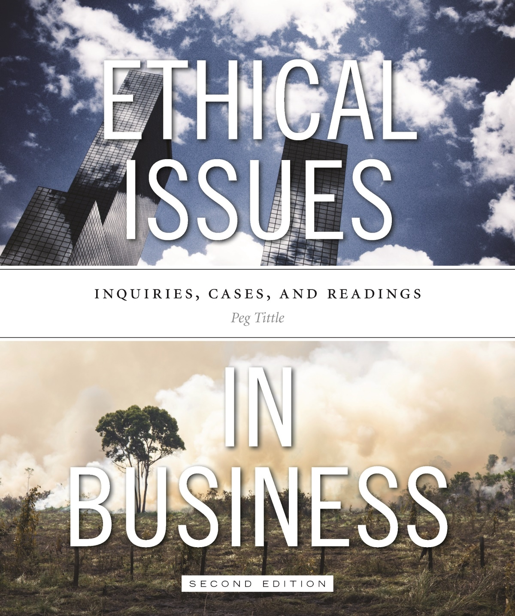
PART III
Ethical Issues in Business
Chapter 6 International Business

Slide 2
Introduction
Many ethical issues in international business…nationalist and economic questions arise:
Should you let your company be partially, or mostly, foreign-owned?
Where should you acquire your materials?
“Cross-border shopping”
Should you outsource production?
By-products of your production process → is it morally acceptable to ship garbage outside the country?

Slide 3
International Business
If your company does establish in other countries:
Do you conduct business according to their ethical standards, or according your own domestic standards?
Translating values and principles into action can be difficult
E.g. Discrimination → what if other country believes it is immoral for women to work?
International context with setting wages → what is the best way to determine what to pay workers?

Slide 4
International Business Cont’d…
On the positive side, multinational companies can benefit host countries by:
Providing jobs
Capital
Technology
Training
Boosting local economy directly and indirectly

Slide 5
International Business Cont’d…
Multinational companies can be detrimental to host countries by:
Widening class divisions
Encouraging urbanization
Providing unnecessary / harmful consumer goods
Changing the way – and quality – of life
Supporting morally corrupt governments
Pre-empting development of local business
Local unemployment through use of capital-intensive technology
Environmental destruction

Slide 6
International Business Cont’d…
How to advertise in other countries?
Will potential consumer understand the ad?
Will the ad be unduly manipulative, given the context?
Should you not market your product?
E.g. Is it wrong to sell nuclear-reactor parts in a country that might use them in nuclear weapons?
Are you morally obligated to market your product?
E.g. If your company makes cheap water-purification tablets, are you obligated to market them to countries without clean drinking water?

Slide 7
International Business Cont’d…
How to sell and price goods in other countries?
Should you charge the same price internationally and domestically?
Is “dumping” morally wrong?
Should you charge a price at all?
E.g. Company Merck and cure for river blindness → those who needed it couldn’t afford it, so they gave it away
What about obligations to shareholders?

Slide 8
International Business Cont’d…
Product safety and quality:
Is it morally permissible to sell products that wouldn’t pass domestic safety standards?
Does it depend on harm – severity, likelihood, duration, etc.?
Does it depend on alternatives?

Slide 9
International Business Cont’d…
Why is the Third World still developing and still so poor?
First World has resources to remedy illness, malnutrition, etc.
Why can’t we distribute wealth and benefits to all who need and want them?
Many developing countries are crippled by foreign debt
Have they squandered? Have corrupt governments taken it all for themselves?...OR…
Did we, do we, steal their stuff – and call it colonialism and free trade?

Slide 10
International Business Cont’d…
Free Trade Agreements (FTAs):
Commendable features:
Voluntary participation
Reliable conditions of mutual market access
Non-discriminatory treatment
Impartial adjudication of disputes
Improvement of human welfare by reducing inefficiencies in trade
Ethical concerns:
Bullying, coercion, deception and manipulation that occurs during negotiation
Partners do not always have the time, resources or expertise to fully understand implications

Slide 11
International Business Cont’d…
One alternative to business-as-usual is “fair trade”:
Standards define what products qualify as fair trade
Producers have to meet specified criteria to qualify for Fairtrade certification:
Labour standards
Sustainable farming
Governance
Democratic participation
Another approach is microfinancing → small amounts make big differences

