Slide 1
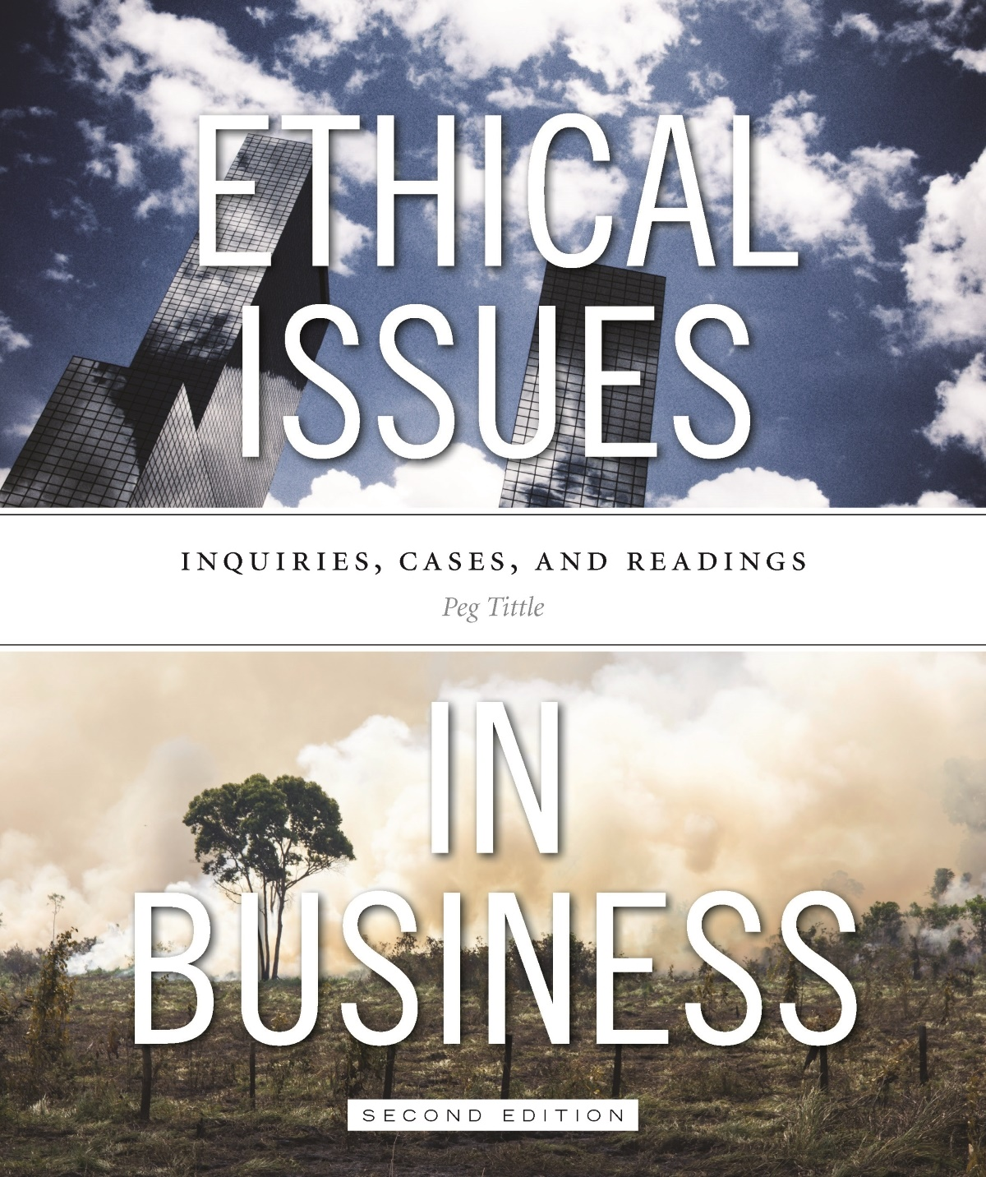
PART III
Ethical Issues in Business
Chapter 5 Management, Corporate Governance and CSR

Slide 2
Introduction
Traditional corporate structure – hierarchy – has several problems:
Leaves little room for respect for the person → subordinate and insubordination imply insulting view of people
Concept of supervisor being responsible for actions of subordinates infantilizes the subordinate
Leaves little room for participation → do employees have right to democratic participation in company’s decision-making?

Slide 3
Introduction Cont’d…
Why do companies have boards?
To protect against dictatorships?
What is the optimal size for a board to be effective?
What should the membership of the board be?
When considering governance, need to look at boards as well as shareholders:
If you own part of a company, are you partly responsible for it?
What are moral responsibilities of shareholders?

Slide 4
Introduction Cont’d…
How important is transparency?
Does full disclosure about one’s business reduce ethical misconduct?
Transparency and accountability affect relationships between employee’s and management; and between management and its board

Slide 5
Unions
Should unions exist?
Indisputable that employers have tremendous power over individual workers
If inequality exists and that such inequality is morally unacceptable, existence of unions is legitimate
Does a union restrict or enhance individual rights?
Are unionized companies more expensive to run? How can they compete?
How and when is it appropriate for a union to recruit members?

Slide 6
Unions Cont’d…
Should membership to unions be compulsory?
Open shop vs. closed shop
What negotiation tactics for collective bargaining are considered ethical?
Bluffing?
Is the adversarial model of management vs. union right? Is it in everyone’s best interests?
To strike or not to strike?
Why are unions against “scabs?”

Slide 7
Unions Cont’d…
Is it ok for unions to look out for themselves at the expense of others?
Do unions have social responsibilities?
Unions are becoming less common due to globalization
E.g. Walmart in Jonquiere, QC shut down after employees voted to unionize

Slide 8
Co-ops
Corporate democracies:
Owned by an association of people or businesses that pool their resources to meet a common need
Each member gets one vote
Difference in communication within co-ops:
More informal and hands-on, directly with customers
Profits distributed among members according to work activity
Are co-ops likely to be more “moral” companies?

Slide 9
Corporate Social Responsibility (CSR)
What is a corporation’s role in, or influence on, the community?
Do businesses have any social responsibility? ...or can they pursue profit as they wish?
Can they be socially responsible AND pursue profit?
We all have responsibility to make the world better → why should businesses be different?
They have MORE social responsibility because they have more power

Slide 10
CSR Cont’d…
Is it a problem that businesses have limited liability?
Ensures that shareholders aren’t personally liable, responsible for debts, damages, etc.
On what moral grounds can you limit your responsibility?
Even when acting out of self-interest, companies have some responsibility to society because without society they have neither employees nor customers

Slide 11
CSR Cont’d…
Why is it so hard for companies to be socially responsible?
Profit motive
Conflicting responsibilities to shareholders
Market conditions
Regulatory environment
Corporations are collectives (diffused responsibility, danger of groupthink or herd mentality)

Slide 12
CSR Cont’d…
Is big business running society?
Companies have assumed state-like roles even though they are not necessarily qualified to do so
Lack expertise → business not equipped to solve social problems
Lack legitimacy → no one elected business people to run society
Blurring of government and business
Governments act like businesses and businesses acts like governments, so both need to accept some social responsibility

