Slide 1
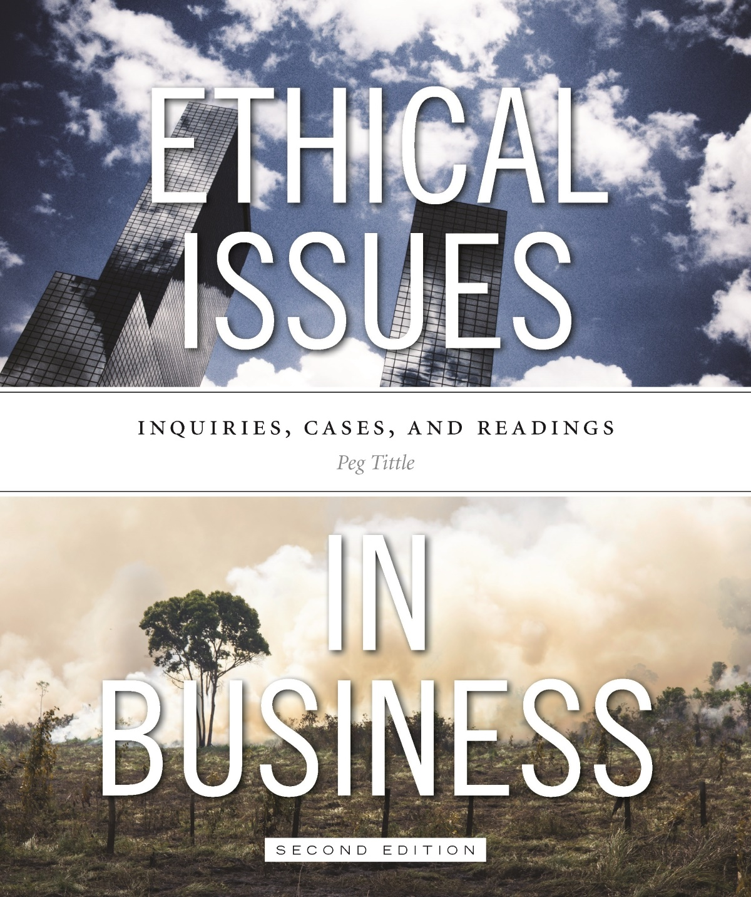
PART III
Ethical Issues in Business
Chapter 4 Employee Rights

Slide 2
Employee Rights
Why only “employee rights” and not also “employer rights?”
Attention focused more on employees because employers tend to have more power
Traditionally, employers have violated employee rights more often
What rights employees have depends on what basis those rights are established
Are employee rights those stipulated by the employment contract? (= contract theory)

Slide 3
Employee Rights Cont’d…
Contract theory ignores that many contracts are not entered into freely
For consent to be truly voluntary, must there not only be alternatives, but attractive alternatives?
Contracts may not stop parties from abusing each other
If rights are established by contract alone, and the contract doesn’t include “human rights”, then the employer can ignore human rights
Modified contract theory → rights and responsibilities accord to the contract as long as no human rights are violated

Slide 4
The Right to Equal Treatment
When considering discrimination, several questions:
What is discrimination?
Is discrimination wrong? When and what type?
If so, why is it wrong?
Discrimination is distinguishing between two (or more) things on some basis that is not justified
Aristotle’s “distributive justice” → like cases should be treated alike, so if you have similar merit, you get similar consideration (regardless of sex and colour, etc.)

Slide 5
The Right to Equal Treatment Cont’d…
Abella’s definition of discrimination:
“practices or attitudes that have, whether by design or impact, the effect of limiting an individual’s or a groups rights to the opportunities generally available because of attributed rather than actual characteristics”
Discrimination defined in relation to membership in a group
This happens when you stereotype or prejudge the individual, attributing certain characteristics according to your view of the group

Slide 6
The Right to Equal Treatment Cont’d…
Kantian ethics:
To universalize the practice of judging individuals according to characteristics of groups would make the notion of “individual” meaningless
Positive discrimination can be equally harmful
Example → it is wrong to assume the distinguished-looking man before us is wise and capable
Need to be vigilant

Slide 7
The Right to Equal Treatment Cont’d…
Unjustified discrimination in the workplace:
Hiring & firing decisions
Promotion and demotion decisions
Recruitment methods
Benefit plans
Compensation and salaries
Purchasing and contract decisions
Product lines

Slide 8
The Right to Equal Treatment Cont’d…
Claims for unjustified discrimination are often based on those listed in Canadian Charter of Rights and Freedom:
Age
Colour
Ethnic or national origin
Race
Mental or physical disability
Religion
Sex
Sexual orientation

Slide 9
The Right to Equal Treatment Cont’d…
What about other unjustified discrimination (not on human rights list)?
Health conditions
Genetic
Weight
Class
Implication that only ability or capacity is relevant
Should the company’s owners be able to hire whomever they want?

Slide 10
The Right to Equal Treatment Cont’d…
If discrimination on basis of irrelevant aspects isn’t morally right, why not stop it?
So subtle and unconscious → we “automatically” make unfair assumptions
Often systemic → not due to individual decisions
Discrimination is hard to root out:
Companies in Canada implement affirmative action or employment equity programs to increase diversity
Leads to more perspectives and helps get rid of stereotypes

Slide 11
The Right to Equal Treatment Cont’d…
Could affirmative action programs be wrong?
Compensation for past injuries does not always work to compensate the individuals who were actually injured
Sometimes they harm target group, who are made to feel like they need “special help”
May perpetuate stereotypes → continually drawing attention to irrelevant differences
Could lead to hiring and promoting genuinely less qualified or capable people

Slide 12
Right to Respect
Two kinds of harassment:
“Quid pro quo” (this for that) → employee is promised something in return for a sexual interaction
“Hostile work environment” → employees work in an environment that is intimidating, offensive or demeaning to them because of comments, gestures, decorations, dress codes, etc.

Slide 13
Right to Respect Cont’d…
“How offensive is offensive?”
According to the reasonable person standard → but a reasonable man might react very differently from a reasonable woman
According to the subjective standard (i.e. if person involved finds it offensive, it is) → but how can one know if someone will find something offensive?
Why is it wrong to offend? Do we have a right not to be offended, EVER? How interfering is interfering enough?
Power relationship → interactions between a superior and a subordinate may have different connotations

Slide 14
The Right to a Job
Is there such a thing as the right to a job? On what basis?
De George → right to employment derives from right to work, which can be derived from right to life, to development and to respect
Weiss → right to a job because a job equals social status and self-esteem
Once you have job, is employer under obligation to let you keep it? Why must they have a reason to remove you?

Slide 15
The Right to a Fair Wage
What is a fair wage? Shaw suggests 7 questions:
What is the law?
What is the prevailing wage in the industry?
What is the community wage level?
What is the nature of the job itself?
Is the job secure and what are its prospects?
What are the employer’s financial capabilities?
What are other employees within organization earning for comparable work?

Slide 16
The Right to Privacy
What exactly is privacy?
Psychological privacy (one’s thoughts, feelings, desires, etc.) vs. physical privacy (one’s activities, appearance and/or personal space)
Right to privacy is the right to control access by others to personal knowledge
How far can a manager or company go to acquire personal information?
Whether to gather, how to gather, what to gather?
What to DO with the information?

Slide 17
The Right to Privacy Cont’d…
Is it an invasion of privacy for an employer to monitor job performance?
Is it fair to read employee’s email messages?
Should employers monitor computer use?
Surveil by video camera employee’s actions?
Can they look at employee’s social media sites?
What is “justified invasion”?
Only what is relevant to job performance?
Information that is relevant to the cost of employee benefits?

Slide 18
The Right to a Safe Workplace
Is employer obligated to provide a healthy and safe workplace?
How safe is safe enough?
Safety is not measured. Risks are measured.
What if employees are willing to work in dangerous workplace?
Can employees refuse any dangerous part without losing their job?
Does foreknowledge of danger matter? (e.g. asbestos)

Slide 19
The Right to Parental Leave
Is it employer’s obligation to provide benefits?
Why? Why not?
Which benefits?
Should parental leave be a right?
Is there something special about children that obligates an employer to provide some benefit to employees?
Why is it the company’s responsibility?

