Slide 1
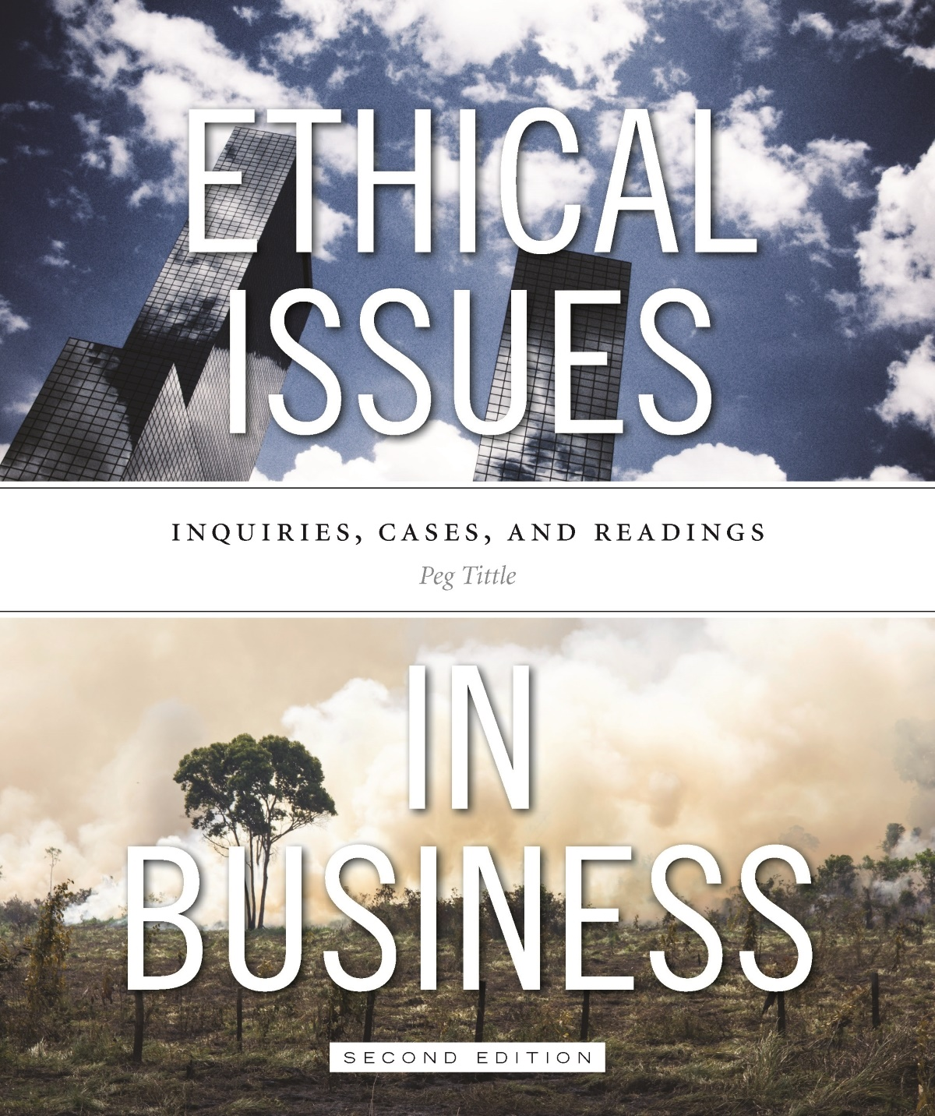
PART III
Ethical Issues in Business
Chapter 3 Product Quality

Slide 2
Product Quality
Is it morally wrong to manufacture or market an unsafe product or service?
Attention to harm = utilitarian analysis
Rights-based analysis:
Consider buyers’ rights and right to choice → measure these against sellers’ rights (to decide what to make and sell and how to market it
Whose rights take priority?

Slide 3
Product Quality Cont’d…
First, ask “how unsafe?”:
What exactly counts as harm?
How likely is harm? How severe? How permanent?
How unsafe is too unsafe?
Health Canada recalls on average 200 products per month
Second, is it okay to make a product or provide a service that’s less than perfectly safe?
Is there such a thing as a “perfectly safe” product or service?
If it is okay, is it okay not to advertise associated risks?

Slide 4
Product Quality Cont’d…
Is it okay to manufacture a less-than-perfectly-safe product even when you can make a perfectly safe one?
What if there is zero profit in the perfectly safe version?
Does it matter why you’re making it? Does intent matter?
What if you are making it so people can afford it?
Do the positive features outweigh the negative features?

Slide 5
Product Quality Cont’d…
If you make an unsafe product, is it then morally permissible for consumers to sue you for damages?
No one is forcing consumers to buy the product
What if your product is addictive?
What if your product isn’t unsafe but simply not effective?
What about totally unsafe products – is it okay to make them?
Weapons are always harmful → should we keep manufacturing them?

Slide 6
Product Quality Cont’d…
Caveat emptor (“buyer beware”):
It is the buyer’s responsibility to find out, not the seller’s responsibility to tell
Is placing responsibility on buyer suggesting that default mode is deceit rather than honesty?
“Due care”:
Manufacturer has responsibility of taking due care, reasonable precautions to prevent harm (“seller beware”)
Who better can afford to compensate for injuries than the company?

Slide 7
Product Quality Cont’d…
Foreknowledge – did the company know of the risk?
How much do we expect company to know about product?
How thoroughly must the company test the product?
How will company know about any side effects?
Is it okay to test on living animals?
Only on those that can give informed consent (i.e. humans)?

Slide 8
Product Quality Cont’d…
Safe for what?
Is it company’s fault if consumer acts unsafely (e.g. putting fingers in snow blower while trying to fix it)?
What is a “reasonable person”?
Safe for whom?
Just people? Or other animals too?
Just those affected in the short term or also in long term?
Are companies obligated to childproof everything they sell?

Slide 9
Product Quality Cont’d…
“Product safety”:
Does this refer only to the finished product or to the entire manufacturing process?
What are the moral obligations of the distributor? (e.g. grocery store stocking fruit laced with pesticides)
Does any of this depend on government regulations? i.e. are we morally bound to conform only to safety regulations?

Slide 10
Product Quality Cont’d…
Obsolescence:
On what grounds can you make a product that will not last as long as it could?
Making short-lived products leads to increased resource use
How and where is garbage transported?
Companies typically cut corners with respect to safety and longevity of products in order to increase profit
Are profits more important than someone’s injury or death? More important than a life-sustaining planet?

