Slide 1
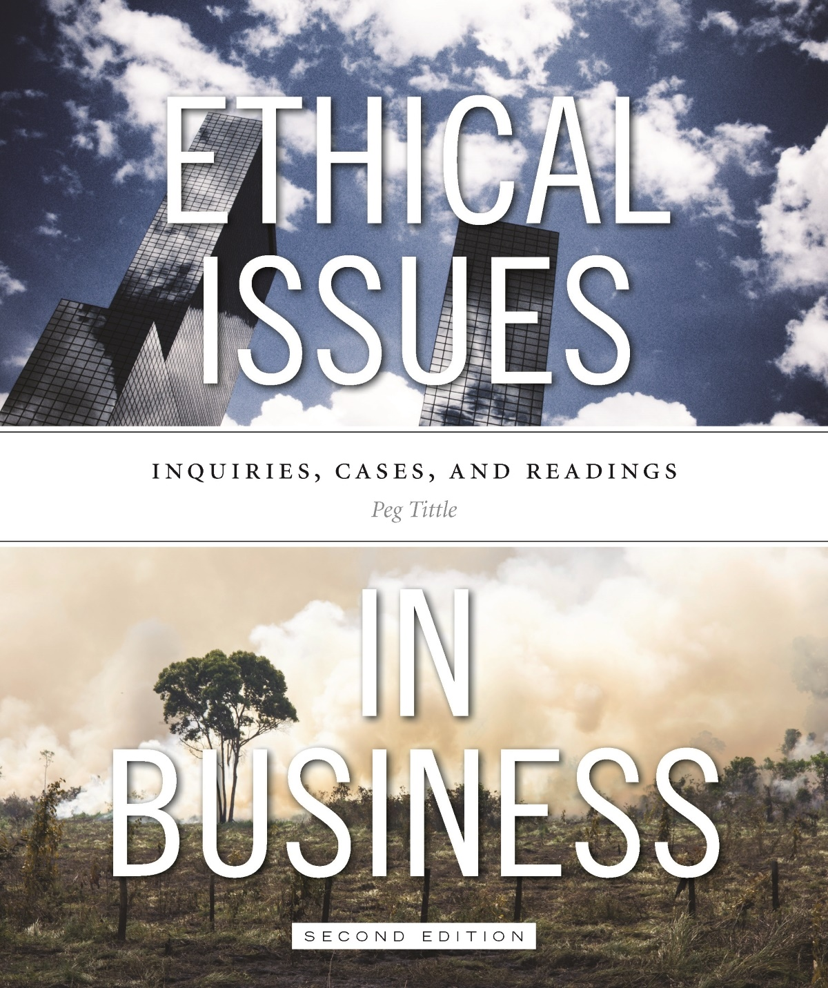
PART III
Ethical Issues in Business
Chapter 2 Advertising

Slide 2
Advertising
What is morally acceptable in advertising?
Is it acceptable to lie in advertisements? To deceive? To mislead?
Is it acceptable to manipulate? Are advertisements capable of manipulating? Does intent to mislead matter?
Consider ambiguities, exaggerations and implications → is manipulation a matter of degree?
Does it matter if persuasion is rational vs. non-rational?
Does medium make a difference?

Slide 3
Advertising Cont’d…
Arguments against lying, deceiving, manipulating, misleading and coercing:
Respect for persons → is consumer a means to the company’s end or as an end in him/herself?
People’s rights → deception undermines autonomy and consequently restricts freedom of choice
Fairness → how can consumer make a fair decision with incomplete or slanted information?
Social good → do advertisers count on consumers being unhappy?

Slide 4
Advertising Cont’d…
Arguments against this type of advertising (cont’d):
Advertising is wasteful → billions of dollars spent per year could improve quality of life
The target rather than the content can be unethical:
Advertising to children; they are not autonomous consumers
Product placement especially potent
Influence of advertising on editorial content
Not advertising to specific groups
Identification of target groups – is “data-mining” legitimate or an illegitimate invasion of privacy?

Slide 5
Advertising Cont’d…
Arguments against this type of advertising (cont’d):
Not only “what” and “to whom” – “where” is also an ethical issue (e.g. billboards can be highly distracting)
“How much” can also be an issue – should the amount of advertising be limited?
Does it matter “what” you’re advertising?
Who is morally responsible for the advertising?

Slide 6
Advertising Cont’d…
Arguments for this type of advertising:
Respect for persons → pursuit of profit and freedom of speech
Fairness → in order for a business to thrive, it needs to let consumers know about its goods and services
Social good
Fosters competition, which improves quality and price;
Informs consumers about what is available
Valuable sponsorship aspect: many organizations and events rely on advertising for funding

