Slide 1
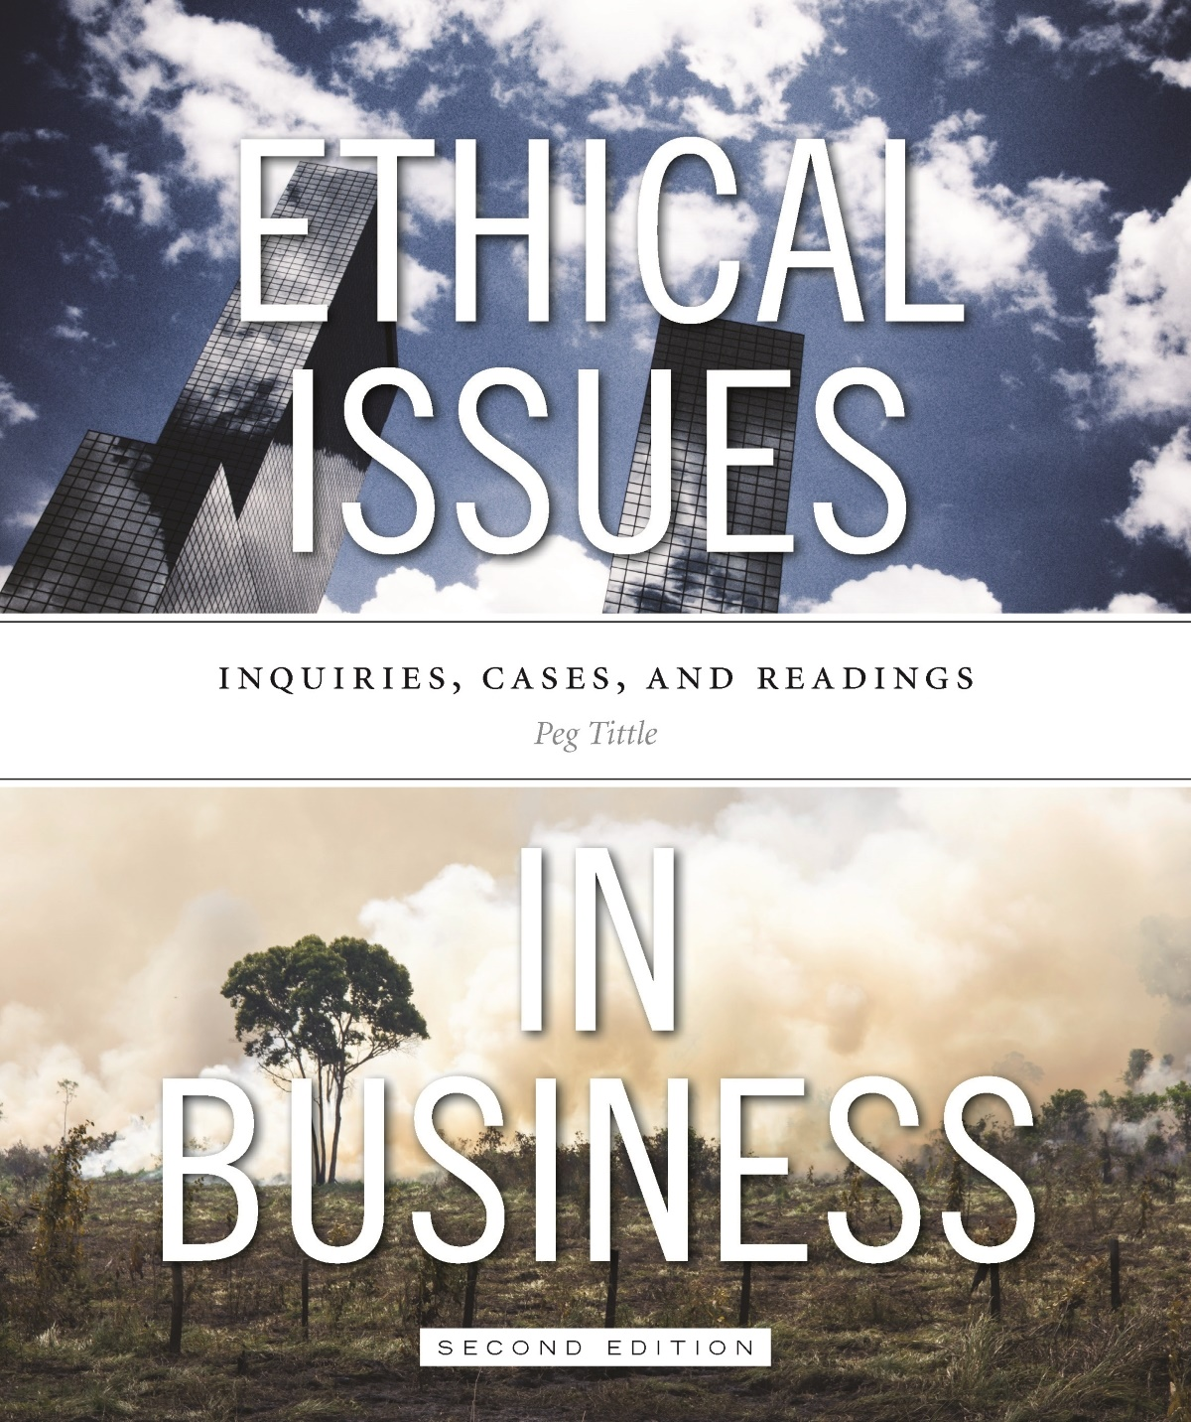
PART III
Ethical Issues in Business
Chapter 10 Business and Our Environment

Slide 2
Introduction
Why should we be concerned about our environment? Two approaches:
Intrinsic value → our environment is a stakeholder; we should refrain from damaging it
Instrumental value → our environment has economic value…what’s in it for us?
Who should bear the consequences (by way of environmental damage) for profit?

Slide 3
Introduction Cont’d…
Assessing consequences to environment is complicated:
Interconnectedness
The environment is interconnected; difficult to contain and identify the specific consequences of our actions
Environmental issues are international issues
Would private ownership help “clean” up the environment?
Far-reaching in terms of space
Earth is a closed system; what goes around comes around
Far-reaching in terms of time
Effects are persistent, they won’t just “go away”
Life-threatening

Slide 4
Trade-offs
Trade-offs between business / profit and environment
Is X worth Y? E.g. are cars worth smog?
Who decides whether the trade-off is a “good” one?
Should governments set regulations to protect environment?
Is conforming to these regulations enough?
Does it matter what you’re producing (does society need it badly)?
How to decide if X is worth Y?
Can we put a monetary value on the environment?
Is the right to a livable environment a human right?

Slide 5
Trade-offs Cont’d…
Are we getting it right?
Business as usual is leading to planet-wide death!
Only in North America is there still discussion about whether or not global warming is happening
Who should fix things? How do we apportion responsibility?
“Polluter pays” → the ones who made the mess should be the ones to pay to clean it up
Egalitarian principle → everyone should pay equally
Ability to pay → the ones most able to pay should pay the most

Slide 6
Trade-offs Cont’d…
How do we make the responsible people pay?
Pollution taxes
Licenses to pollute
Pay countries to keep carbon sequestered (not to develop resources)
Increased government regulations (market-based vs. “command and control” approach)

Slide 7
Sustainable Business
According to DesJardins, sustainable growth should be our new business model:
Businesses should not use renewable resources at rates that exceed their ability to replenish themselves
Businesses should use nonrenewable resources only a the rate at which alternatives are developed or lost opportunities compensated
Businesses cannot produce wastes and emissions that exceed the capacity of the ecosystem to assimilate them.
Can sustainable development be integrated into business as is?

Slide 8
Sustainable Business
Korhonen asks “Is there something fundamentally wrong in the business paradigm in the light of sustainability?”
Korhonen identifies several mechanisms of negative environmental impact, and possible solutions:
Growth without limits (suggesting instead creativity within limits)
Competition (suggesting instead symbiosis)
Specialization (suggesting instead diversity)
Globalization (suggesting instead locality)
These suggestions would lead to “a new, alternative theory of corporate environmental management”

Slide 9
Canadian Perspective
One of Canada’s features is our plentiful natural resources:
Should we develop them?
If we do develop them, what do we do with them? Who do we sell them to?
What processes should we use to develop them?
What is the best delivery method?

Slide 10
Solutions
We have solutions:
Technological solutions
Windmills
Solar panels
Tidal power
Electric cars
Fuel cells
Businesses need to make these solutions work
We need to figure out ways to make business and technology work together

Slide 11
Bottom Line
Decisions being made by businesses are critical, and become more critical with each passing day
Governments have failed to protect the environment → it is time for business to try
We need to be imaginative about companies we start
Be vocal with companies we join
Change the way we do business…quickly!

