Slide 1
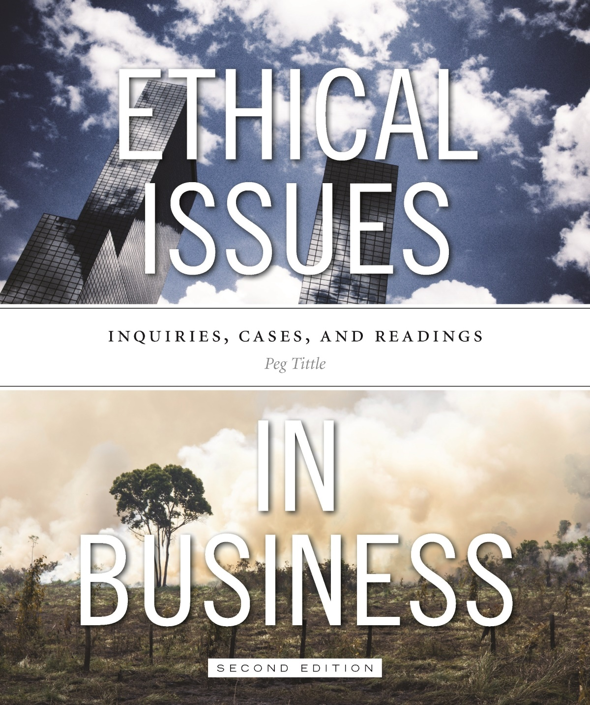
PART III
Ethical Issues in Business
Chapter 1 Whistleblowing

Slide 2
Whistleblowing
Release of information to the public, by an employee of his/her employer’s wrongdoing
“Ethical resister” or “person of principle”
Conflicting interests involving three parties (one must measure and compare their interests):
Public
The company
The individual

Slide 3
Consequences of Whistleblowing
Whose interests have greater moral priority?
Consider consequences → measured in terms of harm and benefit
“How much harm to the public and to yourself would result if you did not blow the whistle?” OR…“How much harm to the public and to yourself would result if you did blow the whistle?”
How to measure harm?
Utilitarian calculus:
How many people would be harmed?
How severe would the harm be?
How long would it last?
How likely is it to occur

Slide 4
Consequences of Whistleblowing Cont’d…
According to Bok, successful whistleblowing:
If the whistleblowing under consideration is unlikely to succeed, then the harm to the public is unlikely to be avoided, and that changes things
Important to consider alternatives → is whistleblowing the best way to achieve consequences?
Did you try other things first, such as internal reporting, to minimize the negative consequences?

Slide 5
Consequences of Whistleblowing Cont’d…
Whistleblowers have duty to verify facts
If not true, whistleblowing could put company in financial jeopardy → negative consequences for all stakeholders
Mistaken whistleblowing makes it harder for future whistleblowers

Slide 6
Intent of Whistleblowing
Whistleblowing can be morally justified solely based on intent
If your intentions are good, then whistleblowing is the right thing to do (whether it succeeds or not)
Motives arising from malice may qualify the whistleblowing as unjustified

Slide 7
Rights, Duties & Obligations
What about rights, duties and obligations to the company?
Is whistleblowing a violation of loyalty to the company?
Do employees have a duty to maintain confidentiality? Does whistleblowing violate that duty?
What about duties and obligations to yourself and others?
Do you have an obligation to be loyal to your family? To society at large? Which obligation comes first?

Slide 8
Rights, Duties & Obligations Cont’d…
What about rights of others?
Does society have a right to freedom of information?
Freedom from harm?
Do companies and organizations have a duty to allow, rather than a right to prohibit, whistleblowing?
Companies committed to high ethical standards should value potential whistleblowers
Create effective corporate whistleblower protection programs
Reduce need for whistleblowing by respecting employees’ basic political freedoms and being truly socially responsible companies

Slide 9
Make it Count
Do not underestimate the politics of whistleblowing:
Companies will likely do their best to squelch the story
The whistleblower may not want publicity that invades privacy and disrupts life, not to mention future livelihood
Can result in demotion and potential harassment
If, after checking facts, you decide to blow the whistle, do so after careful planning – make it count!

Slide 10
Make it Count Cont’d…
Why is whistleblowing still the exception? Why do people allow the “bad” to continue?
According to MacGregor and Stuebs, an individual’s willingness to remain silent depends upon:
Their awareness that an action is wrong
Community ties
Moral competence
Professional standards
Also relevant: knowledge of the consequences to oneself
Is there any easy whistleblowing?

