Slide 1
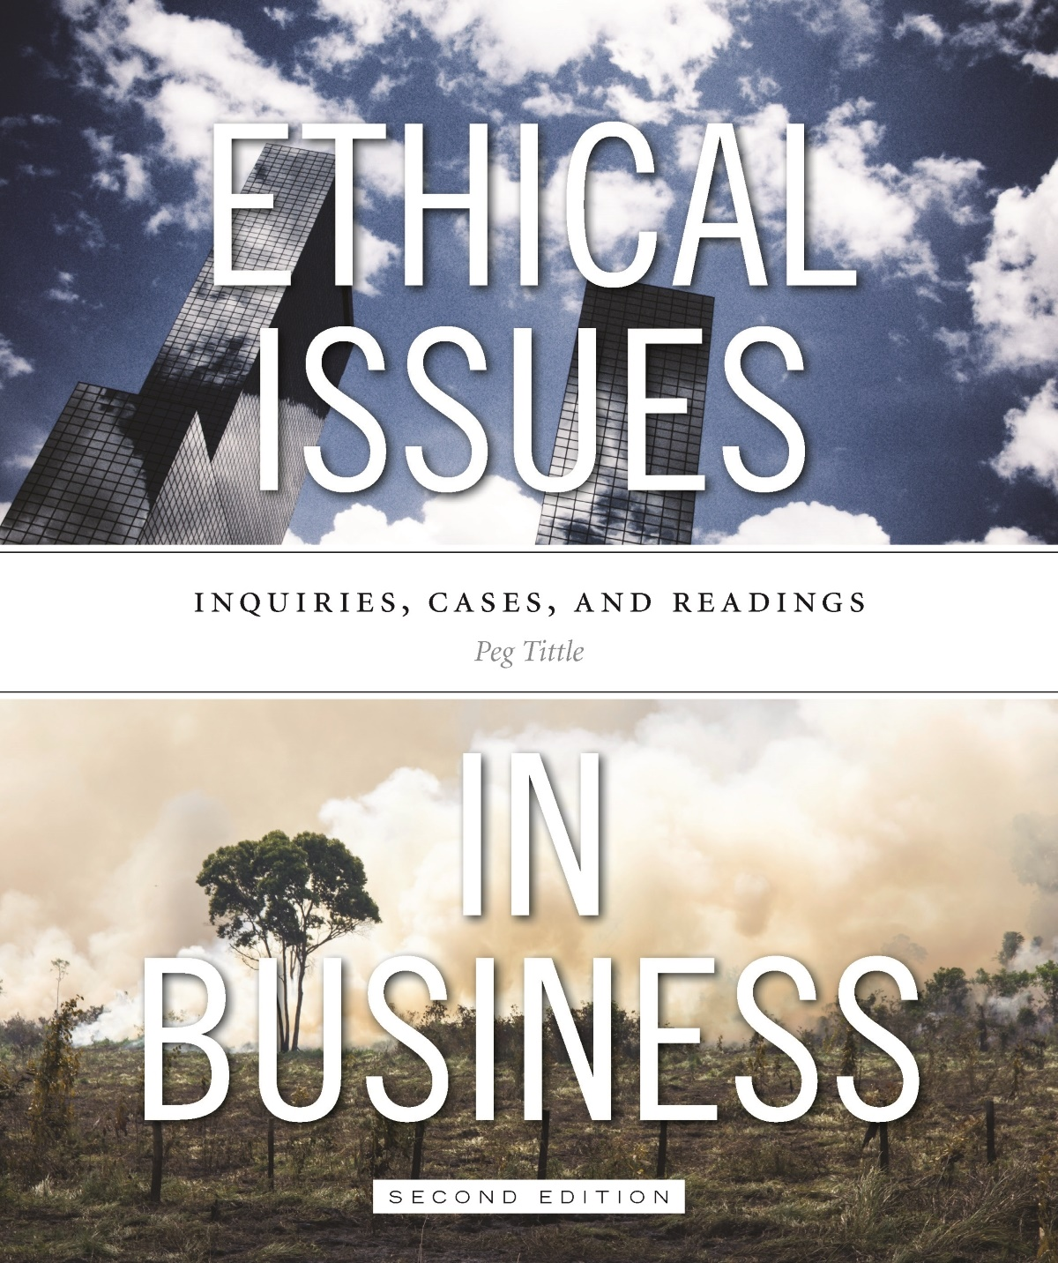
PART II
Introduction to Ethical Theory

Slide 2
Introduction
How to determine if something is right or wrong?
Use ethical theories i.e. different approaches to ethical decision-making
Descriptive theories → what is the case vs. Prescriptive theories → what should be the case
Ethics deals with conceptual questions; uses concepts to explain what should be
Watch for “is/ought” fallacy:
Just because we do something, doesn’t automatically follow that we should do it

Slide 3
Summary of Ethical Theories to Study
Egoism
Utilitarianism
Kantian Ethics
Virtue Ethics
Intuitionism
Rights Theories
Justice Theories
Religionism
Relativism

Slide 4
Egoism
If some action is good for me or in my best interests, it is morally right
Consequentialist theory:
Determines right and wrong according to the consequences, according to what happens
Thomas Hobbes:
Our natural condition leads us to morality of self-interest
“Life is nasty, brutish and short”
Morality itself only comes when we become civilized

Slide 5
Egoism Cont’d…
Distinguish selfishness vs. self-interest:
Selfishness is self-interest even at other’s expense, and to the other’s detriment
Egoists may be self-interested, but not necessarily selfish
May be in our best interests to attend to the interests of others
Notes:
Ayn Rand:
Any action taken for the benefit of others is good, and any action taken for one’s own benefit is evil.
Thus the beneficiary of an action is the ONLY criterion of moral value – and so long as the beneficiary is anybody other than oneself, anything goes

Slide 6
Egoism Cont’d…
STRENGTHS
WEAKNESSES
Who knows better what’s good for us than ourselves?
Works well → people are motivated by self-interest
Adam Smith → individuals who are free to pursue their own interests would be led to achieve the “common good”
Just because something works well, doesn’t make it right
What about people who can’t look out for their own self-interests?
Provides no help with moral conflicts
Sometimes we don’t know what we want; what’s in our own best interest?

Slide 7
Egoism Cont’d…
Activity → in point form, and in your own words, outline and summarize the:
Key elements of theory
Strengths
Weaknesses
Business example using egoist approach to ethical decision-making
Notes:
Ayn Rand:
Any action taken for the benefit of others is good, and any action taken for one’s own benefit is evil.
Thus the beneficiary of an action is the ONLY criterion of moral value – and so long as the beneficiary is anybody other than oneself, anything goes

Slide 8
Utilitarianism
Like egoism, a consequence-based theory:
Why you did something (intent) nor what you did (action) does not matter; only the end result (consequence) counts
Actions have “utility” – they are useful because of consequences they bring about
John Stuart Mill (Utilitarianism) & Jeremy Bentham (Introduction to the Principles of Morals & Legislation)
Notes:
Ayn Rand:
Any action taken for the benefit of others is good, and any action taken for one’s own benefit is evil.
Thus the beneficiary of an action is the ONLY criterion of moral value – and so long as the beneficiary is anybody other than oneself, anything goes

Slide 9
Utilitarianism Cont’d…
Two important elements:
Considers everyone involved – attention to “all concerned” and not only the one performing the action
Hedonism – pleasure is good and pain is bad → we ought to maximize good and minimize bad
= “the greatest happiness principle” (Mill)
Two types: act utilitarianism vs. rule utilitarianism
Utilitarianism is the “greatest good (happiness/pleasure) for the greatest number.”
Notes:
Act utilitarianism - Judges single, one-time event
Rule utilitarianism – judges the rule, the action in general

Slide 10
Utilitarianism Cont’d…
How to measure the greatest good for the greatest number? Hedonistic calculus (Bentham):
Identified seven aspects of pleasure and pain:
Intensity Propinquity Purity
Duration Fecundity Extent
Certainty
Measure the action against these seven aspects
Action with the highest total (of hedons) is the one with greatest pleasure = the morally right course of action

Slide 11
Utilitarianism Cont’d…
Activity: Table II.1
Apply Bentham’s hedonistic calculation to a simple ethical decision:
What is the right thing to do…read that great sci-fi novel or do your business ethics homework?
Using an arbitrary scale of one to ten, assign numeric values to your choices and complete the table on p. 43 of the textbook

Slide 12
Utilitarianism Cont’d…
ACT UTILITARIANISM
RULE UTILITARIANISM
Judges single, one-time act
Example → Is this lie in this advertisement morally acceptable this once?
Judges the rule, the action in general
Example → Is lying morally acceptable?

Slide 13
Utilitarianism Cont’d…
STRENGTHS
WEAKNESSES
Takes everyone into account
Considers everyone equally
Encourages consideration of alternatives
By using hedonistic calculus, provides a solution to moral conflicts
How to identify the pleasures (and pains) and how to quantify the qualities of pleasure and/or pain?
How can we determine who will be affected by the proposed action?
Is pleasure too shallow a measure of morality?
Doesn’t take into account any rights
Ignores the matter of justice

Slide 14
Cost-benefit Analysis
Sometimes considered an example of utilitarianism because it involves calculation of net good
BUT…is it?
More like egoism → not always the greatest good for the greatest number but rather the greatest good for our company
Measures in dollars (not hedons) → attaching monetary value is different than just attaching value
Usually emphasizes short-term consequences
Cost-benefit analysts don’t typically seek morally right answer as much as the strategically right answer

Slide 15
Utilitarianism Cont’d…
Activity → in point form, and in your own words, outline and summarize the:
Key elements of theory
Strengths
Weaknesses
Business example using utilitarianism approach to ethical decision-making

Slide 16
Kantian Ethics
Principle-based theory (the end cannot justify the means):
Do not consider consequences, but the intent
Intents guided by certain principles
Principles are not necessarily absolutes; exceptions may be permissible
Immanuel Kant is most famous

Slide 17
Kantian Ethics Cont’d…
Acts done with the right intent (the “good will”) are right acts
What is the right intent? “That which accords with duty”
What is our duty? “That which is rational”
How do we know what is rational?
Categorical imperative → “Act only according to that maxim whereby you can at the same time will that it should become universal law”
Whatever principle we can imagine everyone following is a principle we should follow

Slide 18
Kantian Ethics Cont’d…
Respect for persons:
“Act in such a way that you treat humanity, whether in your own person or in the person of another, always at the same time as an end and never simply as a means.”

Slide 19
Kantian Ethics Cont’d…
STRENGTHS
WEAKNESSES
Attention to one’s reason for behavior, regardless of the consequences
Universality – there is no “it depends”
Impartiality – everyone is equal; apply the imperatives consistently and fairly
Not as precise as others (e.g. utilitarianism)
Absolutist – allows for no exceptions
Conflicts are problematic – what should one do if two different actions both respect the other’s autonomy and are universalizable?

Slide 20
Kantian Ethics Cont’d…
Activity → in point form, and in your own words, outline and summarize the:
Key elements of theory
Strengths
Weaknesses
Business example using Kantian ethics approach to ethical decision-making

Slide 21
Virtue Ethics
Theory asks: “What is the right kind of person to be?”
The answer is “a virtuous person”
But what is virtuous? Make a list and then justify that list!
Aristotle (The Nicomachean Ethics) listed four virtues:
Justice, temperance, courage and wisdom
Adds a few others: pride, magnanimity, proper ambition, veracity, modesty, gentleness, sincerity, and frankness
ALL virtues are mid-point between two extremes
= “the golden mean”

Slide 22
Virtue Ethics Cont’d…
According to Aristotle:
His virtues enable humans to experience Eudaimonia = broad, well-being happiness
Moral virtue is the result of habit and training; one is taught to be virtuous
Whatever your list, and whatever your justification, you must decide on priorities
E.g. What do you do when honesty and loyalty collide?

Slide 23
Virtue Ethics Cont’d…
STRENGTHS
WEAKNESSES
Virtues are context-dependent
Incorporates feminist ethics (ethics of care):
Virtue of caring is most important, with compassion and sensitivity
Responsibility arising from relationships
Allows for emotion and for social interdependence
Focus on “habit” contradicts emphasis on rationality
Doesn’t help with moral conflict

Slide 24
Virtue Ethics Cont’d…
Activity → in point form, and in your own words, outline and summarize the:
Key elements of theory
Strengths
Weaknesses
Business example using virtue ethics approach to ethical decision-making

Slide 25
Intuitionism
Act according to your intuition – the “gut test”
Follow your conscience – what do we “deep down” think is right?
If it feels right, do it!

Slide 26
Intuitionism Cont’d…
STRENGTHS
WEAKNESSES
Incorporates feelings and emotions
Your conscience is a moral guide
Allows for moral duties and obligations
Unreliability of feelings; emotions are situational
Should we always act on our feelings?
Offers no solution to moral conflict
What if your intuition fails you? i.e. what if you don’t know or your intuition is wrong?

Slide 27
Intuitionism Cont’d…
Activity → in point form, and in your own words, outline and summarize the:
Key elements of theory
Strengths
Weaknesses
Business example using intuitionism approach to ethical decision-making

Slide 28
Rights Theories
It is wrong to violate someone’s rights
Three big questions for rights theorists:
What rights do we have?
Why those and not others (what is basis for those rights)?
In the event of conflict, which rights can override which others?

Slide 29
Rights Theories Cont’d…
NATURAL RIGHTS THEORY
SOCIAL CONTRACT THEORY
We have certain rights because we’re human
We don’t have to do anything particular to earn these rights
Rights can’t be given or taken away (neither forfeited, nor waived, nor traded)
Certain rights are ours because we have done something to acquire those rights
By living in society, we enter into tacit social contract
Respect each other’s rights
Purpose of government is to protect these rights

Slide 30
Rights Theories Cont’d…
STRENGTHS
WEAKNESSES
Violating human rights is an injustice
Difficult to weigh rights of one vs. another – which rights and whose rights are most important?

Slide 31
Rights Theories Cont’d…
Activity → in point form, and in your own words, outline and summarize the:
Key elements of theory
Strengths
Weaknesses
Business example using rights theory approach to ethical decision-making

Slide 32
Justice Theories
Whatever is fair is right
What is fair?
Everyone gets an equal portion (=egalitarianism) OR
Everyone gets what they deserve OR
Everyone gets what they need?
Treating everyone justly does not necessarily mean treating everyone the same

Slide 33
Justice Theories Cont’d
Aristotle divided justice into three kinds:
Distributive justice
Retributive justice
Compensatory justice
Utilitarianism version = whatever provides greatest utility is the most just
John Rawls emphasized human rationality:
If procedure is fair, results will be fair
Must remove biases in decision-making (“veil of ignorance”)

Slide 34
Justice Theories Cont’d…
STRENGTHS
WEAKNESSES
Pre-conceived notions should not taint decisions
Remove bias in order to be “just” and fair
Assumes people are rational
Difficult to determine “what is fair”?
Rawls’ list of primary goods incomplete and does not rank basic liberties

Slide 35
Rights Theories Cont’d…
Activity → in point form, and in your own words, outline and summarize the:
Key elements of theory
Strengths
Weaknesses
Business example using justice theory approach to ethical decision-making

Slide 36
Religionism
Divine Command Theory - two approaches:
God is all-loving and benevolent, thus will command us to do only what is good and right
Whatever God says to do is right – his command defines right
Natural law morality – whatever is natural is right because God made it so
Right vs. wrong is relative to one’s God (=ethical relativism)

Slide 37
Religionism Cont’d…
STRENGTHS
WEAKNESSES
Religion is not a matter of reason
Matter of faith → one must simply believe
Does God exist?
Need to establish God’s moral authority
If one appeals by prayer, how can you be sure God is responding (and not your own mind)?
Problems with the record of God’s word:
Validity, reliability and adequacy

Slide 38
Religionism Cont’d…
Activity → in point form, and in your own words, outline and summarize the:
Key elements of theory
Strengths
Weaknesses
Business example using religionism theory approach to ethical decision-making

Slide 39
Relativism
Individual relativism – right and wrong is defined by each person
“X” is right if I think it is right
Social/cultural relativism – “X” is right if my society or culture thinks its right
John Ladd → “…moral rightness and wrongness of actions varies from society to society…there are no absolute universal moral standards binding on men at all times…”

Slide 40
Relativism Cont’d…
STRENGTHS
WEAKNESSES
Accords with reality
Idea of tolerance and open-mindedness (i.e. no judgement)
What cultural group do you choose?
Which group is morally right and what is the morality of given group?
No objective or universal right/wrong – all views are “equally” correct
Is the majority right? Not always wise to agree!

Slide 41
Relativism Cont’d…
Activity → in point form, and in your own words, outline and summarize the:
Key elements of theory
Strengths
Weaknesses
Business example using relativism theory approach to ethical decision-making

Slide 42
Closing Activity
Chapter Review:
List the questions one would ask, for each theoretical approach, in order to make an ethical decision

Slide 43
Closing Comments
Ethical theories can sometimes:
Be mutually exclusive (they cannot be used together) as they lead to different answers
Operate at different levels of moral thinking
Apply better in different situations
Use theories to get to your answer (not after the fact)
Be sure to critically examine your decisions as well as your approaches to your decisions
Be open to evaluation

