Slide 1
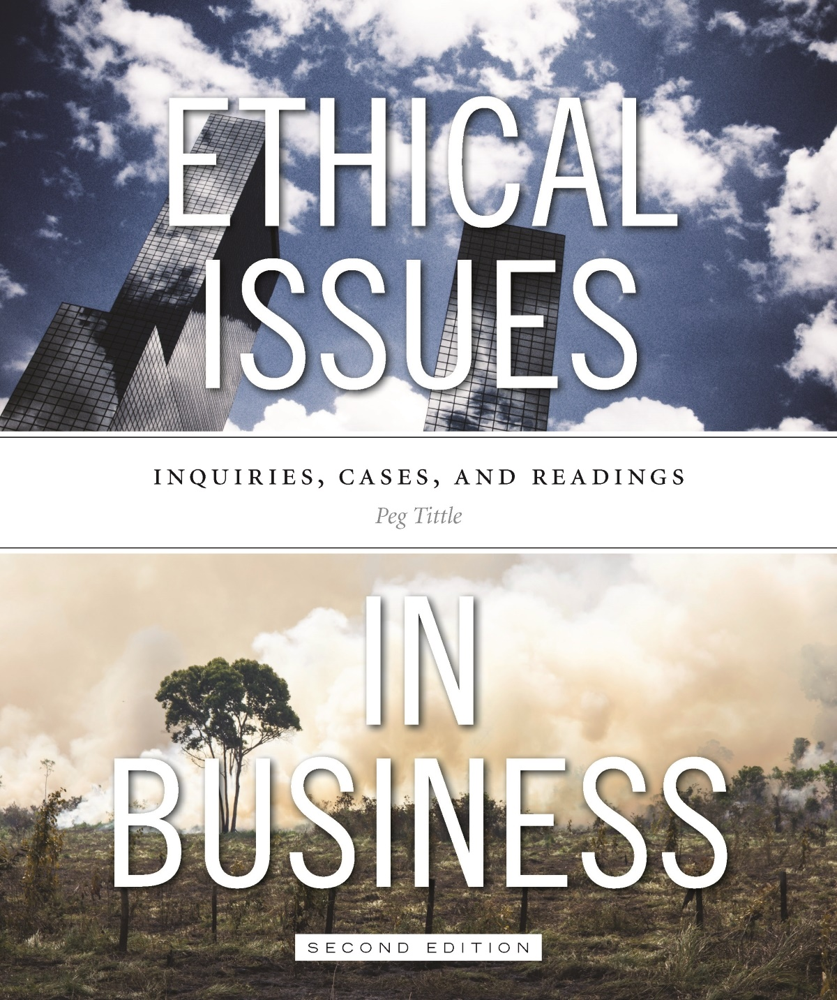
PART I
Introduction to Ethics in Business

Slide 2
Making Ethical Decisions
How do you decide right vs. wrong?
Most moral training stops at 13 or 14 years of age
“What if” questions help us uncover foundations of thought
Someone educated in ethics can distinguish between morally acceptable and morally unacceptable

Slide 3
Role of Ethics in Business
Everyone in business deals with decisions that involve ethics
We all make unconscious ethical decisions daily
Two important questions:
Is ethics the responsibility of only the higher-ups?
Should it be?

Slide 4
Role of Ethics in Business (Cont’d)
It is your responsibility to become involved
Happy employees act in accordance with their own ethical principles
Avoids creating a chain of “passing the buck”
Lets us be “ourselves” at work i.e. no split selves
Ethics are already in the workplace; they’re part of life
Allows us to talk about workplace ethics
Avoid moral totalitarianism

Slide 5
Terminology
What is ethics?
Branch of philosophy
Study of right and wrong
Study of morality
Subject to judgements of right and wrong
What is morality?
System of ethical beliefs or principles
System of morals
No judgement made about this system
Ethical is a synonym for moral → the issue has to do with right or wrong but no judgement is being made one way or the other

Slide 6
Terminology (Cont’d)
Issues can be…
Moral (involve right/wrong)
Amoral (ones that do not involve right/wrong)
Actions can be…
Right (= ethically right = morally right)
Wrong (= ethically wrong = morally wrong = immoral)
People can be good (=ethically good = morally good) or
bad (ethically bad = morally bad = immoral)

Slide 7
How to Think About Ethics
Four important questions (for getting to an answer):
What are your reasons?
Relevant
Adequate
What are your underlying assumptions?
What do you mean by________?
Define your terms
What are the alternatives?
Decision may not be X or Y → try to find a Z

Slide 8
Errors in Reasoning
Several fallacies – errors in reasoning – indicate lack of relevance:
To the person (ad hominem)
Paper tiger
Red herring
Appeal to inappropriate authority
Appeal to popularity
Appeal to tradition

Slide 9
Errors in Reasoning (Cont’d)
Several fallacies – errors in reasoning – indicate lack of adequacy:
vii. Slippery slope arguments (ad hominem)
viii. Post hoc
Mistaking correlation for causation
Confusing necessity with sufficiency

Slide 10
Errors in Reasoning (Cont’d)
Other common errors in reasoning:
xi. Appeal to ignorance
xii. Circular reasoning
xiii. Equivocation
xiv. False dichotomy

Slide 11
How to Discuss Ethics
Everyone is entitled to their opinion…but some opinions are better than others
Be prepared to present good reasons
Think of yourself and everyone else putting forth positions
People can disagree with the position, not with you
Don’t try to defend your self in class, just the position

Slide 12
How to Discuss Ethics (Cont’d)
Method for coherent discussion = “NOODLING”
What is the point you are trying to make?
What is the reason for your viewpoint?
What is another reason for it?
Draw horizontal lines to represent your organized “NOODLES”:

Slide 13
How to Discuss Ethics (Cont’d)
“NOODLING” cont’d → Example:
My membership to the golf club should be considered a business expense
(because)
Sometimes when I play golf, I play with business partners
(and)
Sometimes when I play golf, I meet people who become clients.
YOUR POINT
REASON #1
REASON #2

Slide 14
How to Discuss Ethics (Cont’d)
“NOODLING” cont’d:
Connect your “noodles” to the previous person’s noodles by:
Agreeing or disagreeing with the point
Agreeing or disagreeing with one of the reasons
Add your own counterpoint
Add another reason
Add an example, additional detail or elaborate
Ask for clarification
Question the truth, relevance or adequacy of a point or reason
And so on…

Slide 15
Closing Comments
Be aware:
Try not to use “loaded” language
Be careful with statistics
Avoid moral paralysis:
Make better decisions, more carefully considered decisions, NOT the single absolutely right answer
Remember, ethics is philosophy → requires critical, abstract reasoning
Analysis, synthesis and evaluation

Slide 16
Closing Comments (Cont’d)
Why people don’t typically do the right thing?
Profit at all costs
Herd behavior
Self-deception
Greed
Immaturity
Laziness
Discomfort with “grey”
Ethics = weakness
The business suit

